Slide 1
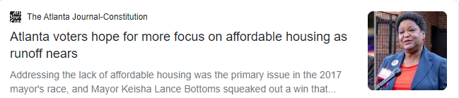
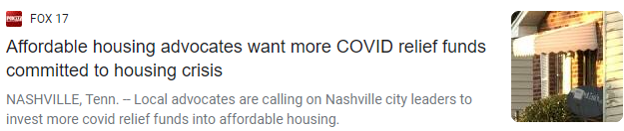
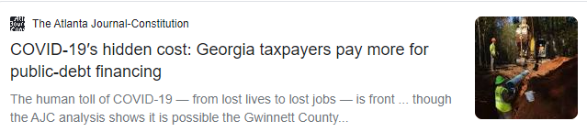

COVID and Affordable Housing In Gwinnett County

Slide 2

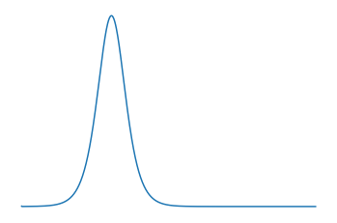
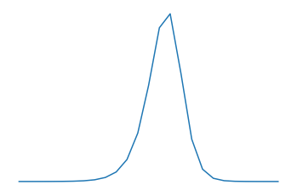
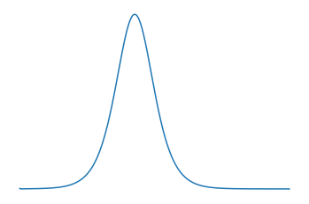
Transmission Model
Transmission Chance r
Chance during an exposure that a vulnerable person is infected
Exposure Rate x
Number of exposures a person experiences per day
High Transmission Low Exposure
Balanced
Low Transmission High Exposure

Slide 3

Assumptions
14 day active window
7 day delay – reporting + incubation
7 day rolling average of new cases
Transmission parameters constant throughout month and county

Slide 4
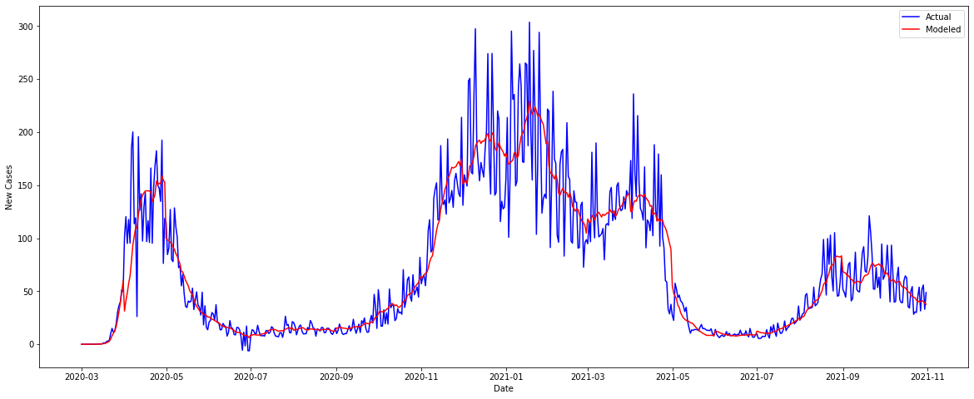
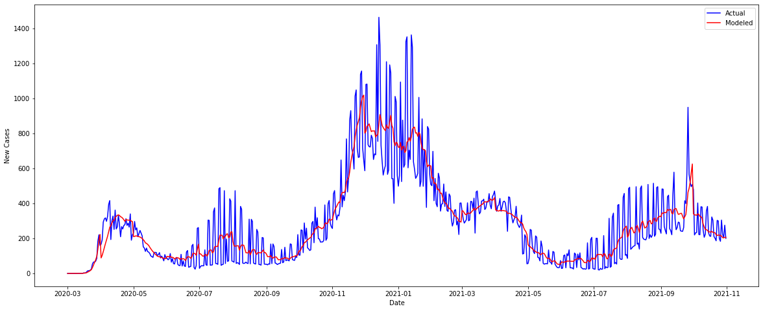
Model Success
Gwinnett County
Atlanta

